Slide 2
Screening for mental and substance use disorders among adolescents on ART in Southern Africa
Andreas D. Haas

Slide 3
Background
Mental and substance use disorders (MSD) are common among HIV-positive people and may negatively affect HIV treatment outcomes
Routines screening for MSD is often not implemented in HIV programs in sub-Saharan Africa and many people with MSD remain undiagnosed and do not receive adequate treatment
Photo credit: Newlands Clinic

Slide 4
Objectives
Prevalence of positive screening for substance use and comorbid mental disorders among adolescents on ART
Associations between substance use and virologic failure of ART
Photo credit: Newlands Clinic

Slide 5
Implementation of routine screening for MSD in two large adolescent ART clinics
Rahima Moosa Mother and Child Hospital, Johannesburg
Public hospital providing care specifically for women and children
1,200 adolescents in HIV care
Newlands Clinic, Harare
NGO clinic providing comprehensive health care
900 adolescents in HIV care
Photo credit: Newlands Clinic

Slide 6
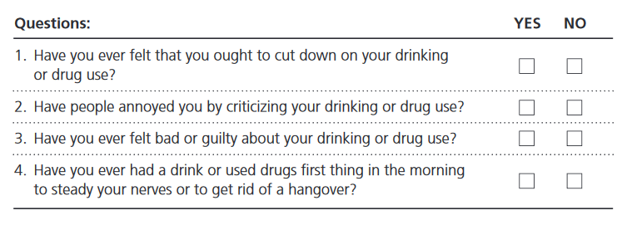
Screening model
Pre-screening:
Depression
Anxiety
Trauma
Substance use
Do you drink alcohol or take drugs?
Full screening:
PHQ-9
GAD-7
PC-PTSD
CAGE-AID
Photo credit: Newlands Clinic

Slide 7
Methods
Study design | Cohort study
Eligibility | Adolescents, 9-19 years, on ART
Definitions | Virologic failure: viral load > 1,000 copies/mL
Statistical analysis | Descriptive statistics Logistic regression
Photo credit: Newlands Clinic

Slide 8
Characteristics of adolescents on ART
 | South Africa n=1,190 | Zimbabwe n=849
Female | 50% | 51%
Age at ART initiation, median (IQR) | 3 (1-7) | 7 (4-10)
CD4 at ART start in cells/µL, median (IQR) | 506 (265-859) | 324 (201-531)
Years on ART, median (IQR) | 10 (8-12) | 8 (5-10)
Age at screening, median (IQR) | 14 (11-16) | 16 (13-18)

Slide 9
Prevalence of positive screening for substance use disorder
 | South Africa | Zimbabwe | Total
Received screening, n (%) | 886 (74.5%) | 304 (38.8%) | 1,238 (60.7%)
Reported alcohol or substance use, (%) n | 38 (4.3%) | 13 (4.3%) | 51 (4.3%)
Positive full screening (CAGE-AID ≥2), (%) n | 10 (1.1%) | 4 (1.3%) | 14 (1.2%)

Slide 10
Comorbidity: mental disorders by substance use status
 | Screened positive for substance use n=14 | Screened negative for substance use n=1,224
Positive full screening, n (%)
Depression (PHQ-9 ≥10) | 5 (35.7%) | 50 (4.1%)
Anxiety (GAD-7 ≥10) | 4 (30.8%) | 29 (2.4%)
Trauma (PC-PTSD ≥3) | 5 (38.5%) | 34 (2.8%)
Suicidal ideations | 7 (50.0%) | 32 (2.6%)
Any mental disorder | 8 (57.1%) | 95 (7.8%)

Slide 11
Associations between substance use and virologic failure
 | South Africa OR (95% CI) | South Africa and Zimbabwe OR (95% CI)
Univariable model | 9.23 (2.56-33.23) | 4.23 (1.45-12.34)
Adjusted for age, and years on ART | 7.27 (1.92-27.49) | 3.15 (1.06-9.38)
Adjusted for age, years on ART, depression, anxiety, and trauma | 6.18 (1.63-23.38) | 2.96 (0.95-9.23)

Slide 12
Adjusted hazards ratios comparing virologic failure between adults with and without substance use disorder
Virologic failure

Slide 13
Summary & conclusion
Few adolescents on ART screened positive for substance use disorders
Our study likely underestimates the true prevalence of substance use due to underreporting
The majority of adolescents with substance use disorder had one or more comorbid mental disorders
Positive screening for substance use was a strong and independent risk factor for virologic failure of ART
Routine screening for and pro-active management of mental health and substance use problems may be critical for ensuring better health among adolescents living with HIV in Southern Africa

Slide 14
Acknowledgements
Patients and staff at Rahima Moosa and Newlands Clinic
Co-authors: Karl Technau, Mpho Tlali, Bahati Kasimonje, Shenaaz Pahad, Kate Braithwaite, Mampho Madzivhandila, Gillian Sorour, Shobna Sawry, Cleophas Chimbetete, Mary-Ann Davies, Matthias Egger
IeDEA Southern African collaboration
Funding: National Institute of Health (NIH), Swiss National Science Foundation (SNF)

